Slide 1
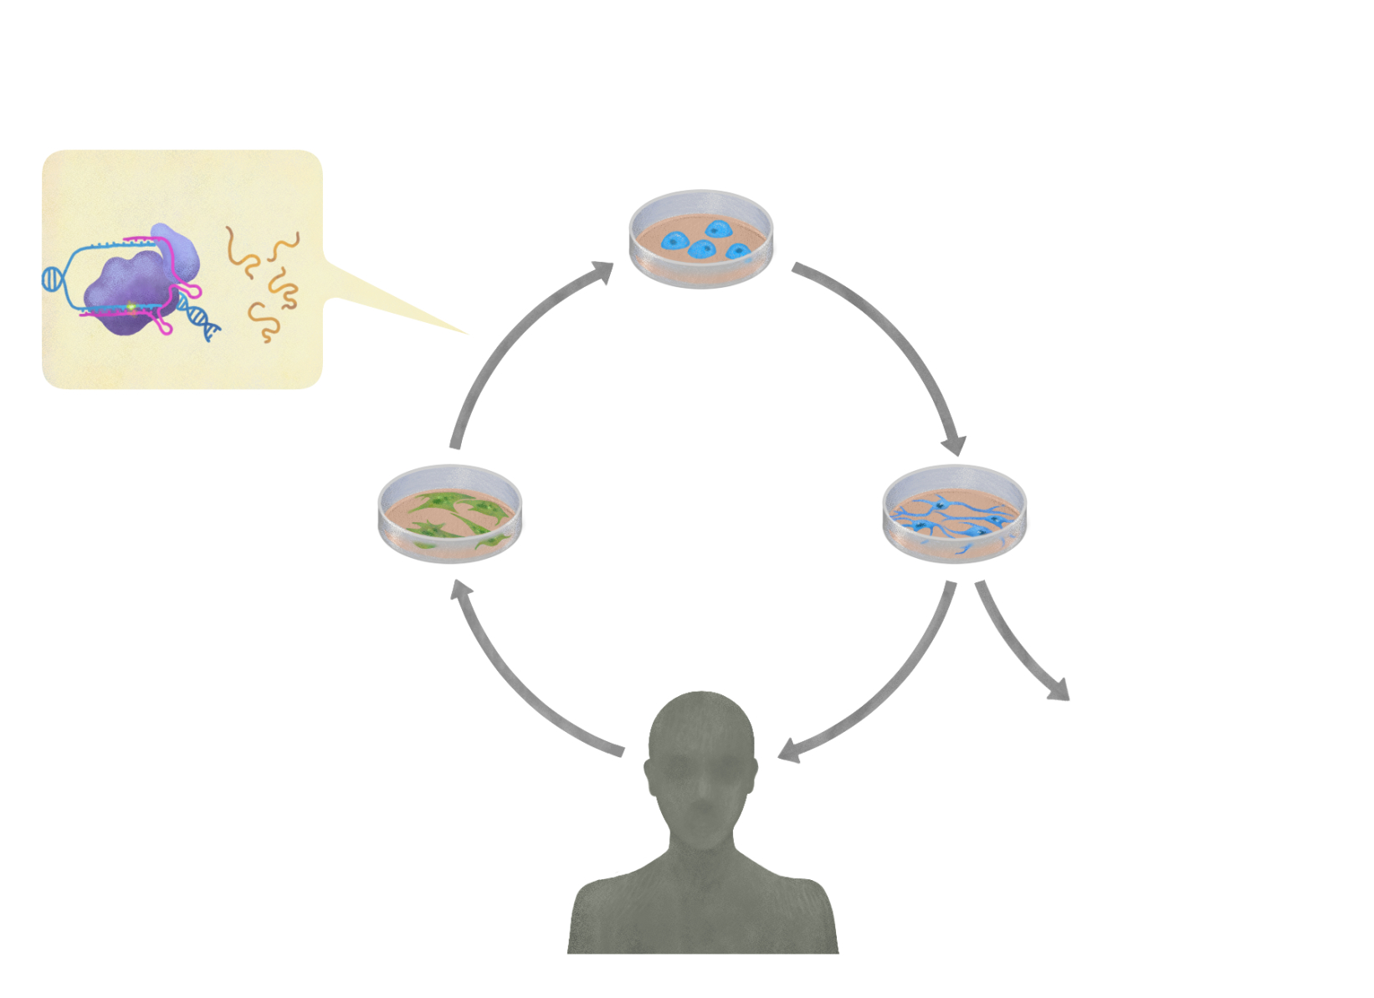
One-step strategy
Corrected hiPSC
Skin biopsy
Differentiation
Transplantation
Prime editing + reprogramming
Fibroblasts with
familial PD mutation
Dopaminergic cells
Safety & efficacy testing
Familial PD patient

